Slide 1
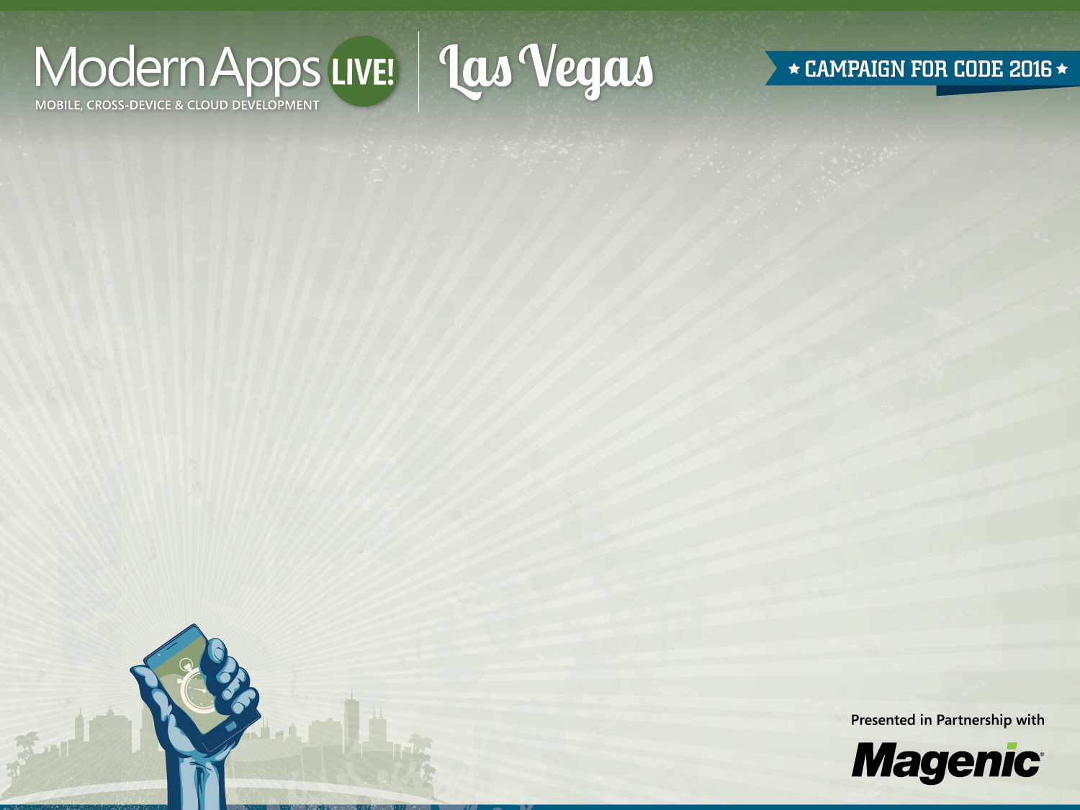
DevOps and Modern Applications
Dan Nordquist
Architect, Magenic
Level: Intermediate
T20 - Tuesday, March 8 3:00pm – 4:15pm

Slide 2



Dan Nordquist
Minnesota
@dnord
MyVote
Notes:
Hi! Thanks for coming to my talk.
First off, who am I?
I’m Dan
I came here from Minnesota
I work at Magenic and I’m a software developer / team lead.
I’ve run teams for the past 5-6 years,
I’ve been in consulting for about the last 10, and I’ve worked in banking, marketing, commerce, financial services.
I’ve been on the MyVote team and the Modern App Live team for about a year. I look after DevOps stuff
I’m a really big Twitter user - dnord.
I’ve done more dev than ops, but I’ve done more ops than a lot of devs
So the idea that those two things are coming together is really exciting to me.
My dream job is to talk to developers and coach development teams on how to take ownership and responsibility for the flow of value to the customer.
Technology: I’ve been on the Microsoft side
web developer, I’m not deeply attached to Microsoft’s direction.
love the idea of using the best tool and finding ways to support people in the tools where they feel most comfortable.
Mostly, I consider myself a problem solver and a team player.

Slide 3
Background
Clients and Projects
Octopus Deploy
Release Management
DevOps Recommendations
Notes:
So how did I get involved in DevOps?
I started in the space a few years back when I had a client that was bringing some Windows software into their open source world. They wanted to run it on any number of Amazon servers, and they asked if I could help with Chef and PowerShell.
This was my first experience with automated scalability, or leaving code in charge of something that usually we’d expect humans to do. I thought the cloud was awesome because I could use a web interface to spin up machines rather than work with an IT group. I was in charge. So it was my first experience scripting an infrastructure with a text file.
Since then I’ve been at clients that are developing in the cloud for Office365, clients that have been implementing Octopus Deploy to automate deployment, and my latest client is one that asked me to survey the landscape and make DevOps recommendations in their enterprise.

Slide 4
You
Developer / Operational? (Split?)
Keeping up with trends, but want advice
Interested in where this is going
Familiar with some ideas, maybe not specific tools or tactics
Notes:
But enough about me, I want to make sure you’re in the right room.
My hope is that you’re a software developer or that you have a job related to software somehow.
Or maybe ops!
I assume that the line between dev and ops is a little blurry for you, I’m meeting a lot of people where the boundary is unclear
I expect that you’re keeping up with trends and reading about what’s new.
But you want advice from someone who’s been there, either that they’ve done the work or done the research.
I assume you’ve met the MyVote team and know what the MyVote project is, and you want to learn more about how the dev team for MyVote has applied this thinking.
I expect that you’re at least interested in what’s happening in the space, and that you’re not here in a defensive pose.
If you are, I hope to bring you out of it
I assume that you are not deeply familiar with these tools yet, because most people at dev conferences aren’t, but I don’t intend to train you on anything today. I want you to be aware of what’s out there so you can pursue a path that’s right for you.

Slide 5

“It’s not a how-to book, it’s a why-to book.”
-Joshua Fields Millburn
Notes:
This slide describes my philosophy for all my talks
It’s not a how-to book, it’s a why-to book
So what does that mean
Joshua Fields Millburn writes about minimalism on the Internet, just focusing on living your life with less stuff
He writes with a passion for self-development and self-improvement but he doesn’t lay out the seventeen steps that you personally have to take on your journey.
He sees his job as illustrating the concepts and inspiring people to care enough about it that they figure out the next steps themselves.
So there’s no blueprint here, and the only examples I’m going to give are about how we’ve actually used this on our project to make our lives easier.
It’s my hope that you don’t find this fluffy or super-high-level or introductory – this is our real work

Slide 6
DevOps
Agile is foundational to DevOps
DevOps is primarily about culture
DevOps includes tools and metrics
Microsoft-stack developers are invited
Notes:
So here’s your last introductory slide, last chance to leave
I want to illustrate that devops is based in agile, and that agile is the foundation for this devops thinking
Second, I want to plead with you that devops is primarily about culture. If you don’t build a devops culture, these devops tools are going to be cutting against the grain for you.
Third: about automation and metrics. These tools expose your bottlenecks and inefficiencies, and I think it’s what most people think about when they think about devops.
Fourth, applying this to the Microsoft stack. If you’re a developer like me, maybe you feel a little left out or intimidated, and I want to show you that everyone’s invited

Slide 7
Agile Foundation
Our industry’s best answer yet to management and production
Suited to the realities of the software world
Based in inspection and adaptation
A work in progress
Notes:
Show of hands: who knows what agile is, and why it’s important?
That’s what I thought – this talk used to explain far too much
Real quick – agile is how our industry tracks and encourages production and ownership
The publishing industry has their workflow
Manufacturing has its techniques
The logistics industry has their models and management
Medicine has protocols and practices
Software has agile, which is suited to software
Of course you can build software other ways. Of course you can.
You take on a lot more risk
You ignore the valuable flexibility inherent in software work
It’s not the only way, and it’s not the only good way – it’s just the best way we have right now
Inspection and adaptation drive agile.
I see companies that are racing to deadlines with agile, not inspecting.
I see companies fixed in what a coach taught them, not adapting.
Stay aligned with the ideals, but fix what’s broken!
I see companies entrenched in arguments, not addressing the real concerns of others. And failing.
Agile keeps changing because software is a young industry
We in technology have to work with all these other industries.
The methods of the food server world don’t overlap a ton with the protocols of the astronomy world, right? But we have to adapt to every industry.

Slide 8
Agile Gaps
Dev
IT
QA
Customers
Security
Data
Notes:
But Agile has gaps.
Even really strong dev teams find that, unless they’ve really intentionally built out cross-functional teams, they’re not as efficient as they’d like
IT
The IT gap is where DevOps comes from.
IT people started borrowing agile concepts like Kanban
“Whoa this is cool”
Between two efficient and healthy siloes, there can still be a gap
You have to introduce an intentional connection between those orgs, or have one agile process that includes them both
Deployment is the highest risk touchpoint
We have to do better than throwing code over the wall, or with documentation attached.
Security
Security is mandatory in the enterprise.
Their involvement can be a little waterfall.
If your security review is scheduled for the end of your project, then that’s an agile gap.
If you invite security into earlier reviews, and they don’t attend, then they’re off in their own silo and they’re reacting, not planning.
QA
QA is a really good example of waterfall management techniques.
If your testing is reactive, happens “after” development, that’s a waterfall handoff.
Even when QA is included in sprints, sometimes it’s one sprint later?
Customers
We try to have the product owner represent the customers, but a lot of the time we let them worry about the business more than the customers.
The value is to the business, of course, but business is about providing a product or a service – makes no sense to cut off the customer in that conversation.
Does customer feedback make it into the revisions of the product? Does their behavior or input contribute to inspecting and adapting?
Data
This is a last-second addition
Well-meaning database folks have told me that database work doesn’t lend itself to agile software development.
Boo.
If you’re working with a database architect that recommends spending six weeks on database design, after analyzing the needs of a new application, that guy isn’t on your agile team. He’s of in his silo.
One observation – does the universe revolve around Dev?

Slide 9
DevOps Culture
Tear Down Walls
Be Inclusive
Communicate Effectively
Automate Deployment
Practice CI
Deploy Confidently
Gather Metrics
Maintain Flexibility
Embrace VM / Cloud / Docker
Develop Rapidly
Clear Obstacles to Collaboration
Create a Quick Start Package
Analyze with the Backlog in Mind
Define Key Measurements
Encourage Cross-Pollination
Create Visualizations
Provision Instantly
Listen and Empathize
Detect Problems and Practice Recovery
Branch Wisely, and Release Unfinished Code
Notes:
This is a slide I show clients who want me to explain DevOps culture.
I can look at this and I can walk it around your organization and people will tell me if you’re doing this stuff or not.
Top-performing dev teams are obsessed with developing rapidly
not doing that by ignoring best practices, they’re doing it by clearing obstacles
they may want to create a quick-start package, maybe something with NuGet,
so that the first, easiest decisions about the frameworks supported by the enterprise are just there automatically
Enterprise logging, service bus, Bootstrap, boom, I don’t have to track those libraries down before I get going on a new project.
working with IT to make sure that the new guy gets his VM, fully loaded, as soon as possible.
deploy confidently.
How often is deployment a big deal?
And does it happen less frequently when it’s more painful?
Of course that starts with building and deploying it more often (practice)
using scripts
using software
And making sure that we integrate features as frequently as possible (practice).
Frequent integration might mean integrating stuff that’s not done
learn how to hide unfinished features rather than branch them forever.
If your software doesn’t have an architecture that supports feature flags, maybe consider it.
branch wisely and consistently.
I’ve seen teams argue about these even as they try to embrace continuous delivery.
You don’t know how to branch, and you want to release every day?
Communication
Inclusive
notice who’s not included, and where communication stops, and they fix it.
try to find gaps in respect and empathy and they try to fix it.
Nobody wants to go to work and be ignored or not listened to.
And the communication that does happen, then:
they’re sharing information in a way that’s persistent, searchable, discoverable… using tools like Basecamp or Slack or Discourse or Yammer, so everyone can stay in touch, but nobody’s required to be interrupted.
They’re interested in the data that their app can generate.
They gather metrics religiously.
I come from marketing – they gather metrics like crazy.
They know ROI for everything they do.
Do they ROI the design or technology decisions they make? No. They didn’t understand technology, it was just an expense to them, and they kept it at arm’s length.
They work with the business to define key measurements and they listen to what those metrics tell them.
They push that information to people that need it, and
discuss it with the product owner, who can push things into the backlog.
And they spend time creating visualizations so that you can quickly understand the landscape without understanding everything about the domain.
they maintain flexibility.
I ask about VMs.
If VMs are sound, I ask about VM management.
If that’s good, I ask about the cloud and autoscaling.
If that’s good I ask about containers and how applications need to be architected to work in containers.
And I also sit with IT departments and disaster recovery folks –
how frequently do they practice? Are they self-inflicting downtime so they know what to expect when it’s unexpected?
This about more than just agile development and agile IT – it’s about agile people being flexible about their responsibilities.
If someone asks for help, is that “not my job”?
Or are people open to learning from each other?
If you don’t have that cross-pollination you’re missing out.
The best high-end database guy in the world is worth nothing unless I have a high-end database problem.

Slide 10
Dev
Ops
?
Notes:
Here’s a pattern to avoid
You’ve got dev, and ops, two tribes
As long as they are two tribes, there’s nothing you can buy that that makes these one tribe.
There are tools that enable devs to reach across that boundary easier than before.
And vice versa.
There are communication tools that can make it easy for them to talk to each other. But they have to believe they should.
In fact, orgs that are tied to a single software solution to manage change are the ones that are having the toughest time with DevOps transformation
They don’t know how to do it without the software.
Diversity in tooling is strength.

Slide 11
Dev
Ops
DevOps
?
Notes:
My worry is the people get motivated about DevOps and they do this.
New tribe
Three communication paths when there was just one before.
No trust and not much overlap.
Culturally you’ve just complicated things, not improved it.
Dev and Ops are pretty sure they’re not supposed to talk to each other.

Slide 12
Dev
Ops
Notes:
What you’re looking for is this.
people on your dev teams who care about the ops side and can own it.
people in ops who care about this stuff but won’t abandon their chief concern.
a culture where it’s okay that the line is a little blurry, and nobody has to justify solving a problem on the other side of the imaginary fence.

Slide 13

You create culture by encouraging behavior
Notes:
You create that culture by encouraging behavior. Even if people are interested in this stuff, it’s no failure of theirs that they aren’t exposed to everyone else’s jobs.
First story is about a project I was on, migrating applications from server to server. That involved SQL, but we interacted with the SQL team through their ticketing system. Every day at stand-up developers said “I submitted the ticket” like that was the end of the line. The developers weren’t wrong – they were doing what they understood to be the right thing. I said “could we invite them to stand with us every day” and they did. We got buy-in from them, they started acting like they were part of the team, when the topic of their work came up I stopped people and I said “okay, SQL guys, what do you think about that?” It changed everything.
Second story is a company I know where, when you’re hired as a developer, you spend two weeks in customer support before you write a line of code. You’re answering phones or emails and understanding why your customers use your software. I’ve heard of other companies where developers rotate through shifts on production support. One week a year you put down your code and you work with the people who support the users.
Third story – a client of mine was spending four hours for each deployment renaming and recompiling services. Their monitoring processes insisted that each deployed service be tagged with the environment in which it was running. So these services, and the WiX packages that installed them, all needed filename and assembly-level changes during compilation.
We built a PowerShell script that updated the csproj files, the assemblyinfo, etc. and built four versions of each.
That’s not the point: the point was that the development team had never questioned that requirement. We knocked it down from an error-prone four hours to a rock-solid fifteen minutes, but we handed that solution over with the caveat that it was a problem that didn’t need to exist and probably should have been a conversation. But they weren’t interested in that. DevOps culture is interested in that.

Slide 14
CAMS
Metrics
Automation
Sharing
Culture
John Willis, 2010 (!), https://www.chef.io/blog/2010/07/16/what-devops-means-to-me/
Notes:
We look to culture as the solution to the agile gaps I mentioned earlier. This can happen in any organization.
John Willis, works at Chef, coined this acronym for DevOps thinking, and it’s CAMS
Culture
That’s what we just discussed.
Automation
People associate automation with devops, but automation doesn’t work if your code is broken
Automation doesn’t work if your culture’s broken.
It’s not safe to accelerate if your engine’s not sound.
Why Automation? Automation is cool and everything, but why?
Automated deployment reduces the time to deliver value. That cuts waste.
Who here has read about Lean and waste?
Automation allows you to manage risk by integrating changes into the production environment one step at a time, very small deltas, before they get to be complex and unmanageable.
Metrics
Why metrics? Because you need feedback.
Good feedback is how you course-correct.
Imagine a stoplight that gets feedback vs. one that doesn’t.
Immediate feedback is how you validate that a team is building software that matters.
Data is the foundation of feedback. Collecting that data is key.
And it’s easy. It’s something that code can do with its eyes closed.
Sharing
We won’t cover sharing a ton, but I’ll say that this work is based in open source
Sharing’s what I’m doing right now.
Sharing is why DevOpsDays are $200 and not $1000.
Open source software is competing with commercial software, and it’s built on sharing.
That’s worth pondering. Deeply. What parts of open source, and not just software, but open source culture, can be brought into your org?

Slide 15
DevOps Concepts
Idempotence
Desired State Configuration
Infrastructure as Code
Virtual Machine Management
Release Management
Containers
Notes:
I want to talk about tools,
but tools are organized under a few key concepts, and I want to explore them here
We’ll talk for a second about idempotence
We’ll look at Desired State and what that means, both in the automation and provisioning space
Infrastructure – controlling it through code
We’ll talk about Virtual Machines and how important it is to manage them like Virtual Machines
We’ll cover Release Management
We’ll talk about Containers

Slide 16
Idempotent
Preliminary State
Desired State
Desired State
Desired State
Notes:
Idempotent just means “it works, and there are no unwanted side effects”
If you create a stored procedure by saying “if not exists” then that’s idempotent – you should be able to run it whether or not you’ve run it
Running some installers creates a second instance of the application – not idempotent
If I script the copying of a file, and that script errors out because the file’s already there – not idempotent. I want it to say “OK”, I tried to do it but it was already done, not “there was a problem”.
Different mindset for how we think about system change.

Slide 17
Desired State Configuration
Declarative statements drive underlying behavior
If this is idempotent, I can run it as often as I want
If this is text-based, I can keep it in source control
C:\> choco install -y googlechrome dropbox 1password winmerge todoist sublimetext3 pdfcreator virtualclonedrive filezilla fiddler4 linqpad 7zip git markdownpad2 vlc workrave
Notes:
Desired State Configuration is based in idempotency.
Desired State is a script, let’s say, that defines how I want the world to be
We do something declaratively that drives underlying behavior
I can run this once or schedule it – no harm if it’s idempotent, right?
Track those runs and get data about them
Keep it in source control and track changes
Always know what changed and when
On the right, Chocolatey! Who knows Chocolatey!
When Windows shops want something low-hanging, automatic, for devops, I say Chocolatey
Based in NuGet and PowerShell
You install this on your workstations and then that’s the last thing you install manually
Chocolatey has a repository, maintained, of where to get software and how to install it
But this is my install set. Any new machine, I run this, I get 14-15 applications that are important to me.
I can run this as often as I want
Or once
I can put this into source control and track when I started using each tool
And every machine I have can be in sync – they all have the same software
If you’re thinking what I’m thinking, you want something like this running on your servers, because they have software they’re running

Slide 18
Desired State Configuration
Setting up VMs is not hard, but if it’s manual, it’s inconsistent
Configuration drift happens
WindowsFeature IIS
{
Ensure = "Present"
Name = "Web-Server"
}
WindowsFeature installdotNet35
{
Ensure = "Present"
Name = "Net-Framework-Core"
Source = "\\fileshare\Windows2012\"
}
WindowsFeature ASP
{
Ensure = "Present"
Name = "Web-Asp-Net45"
}
Notes:
DSC is a concept but also software from Microsoft, part of PowerShell
I don’t like the name but that surprises nobody
If they called it “Microsoft Raised Fist” or something then people would know about and care about it
But it’s basically just PowerShell plugged into Windows Server’s ability to turn features on and off and configure them.
If every machine in your orgnaztion can just call into these scripts, or the compiled output of these scripts, which is a little more complicated, then you’re set
A DSC server can be coordinating a number of servers, or you can inject the desired state into the server as it’s provisioned and just have it configure itself.
People get squirrely, right? If you get comfortable with this and then reduce the access that people have, then you minimize the squirreliness in your infrastructure.
If you have the discipline, you can put this in source control – it’s code. Much easier than creating an image (which I’ve seen done) which you then keep a couple gigabytes of a virtual machine laying around.
The golden image

Slide 19
Desired State Configuration
Setting up users can also be inconsistent
This should make security people really happy
User DanNordquist
{
Ensure = "Present" # or "Absent"
UserName = "mach3\DanNordquist"
Password = $passwordCred
}
Group PowerlessTesters
{
Ensure = "Present"
MembersToInclude = "mach3\DanNordquist"
GroupName = "PowerlessTesters"
}
Notes:
And it’s not just features, but very many aspects of Windows Server administration are included.
One really easy step for organizations trying to get started in DevOps is just auditing which users have permissions where.
Inconsistency is the enemy of IT organizations. And inconsistent security is a nightmare for sec folks.
Once that’s captured, document it, and then enforce it with something like this. You want to make sure I have a local account on your dev-only system, that’s great.
This way nobody loses track of what permissions or roles or users should be a part of a server setup. If you can’t recreate it, it might as well not exist.
Do this right, and it’ll wipe out any new admin users that are created. Good news, right? Because new users shouldn’t be created manually. They should be created by the script, which should be in source control, which makes this finally visible.
You can see above, the password is a variable, that can be injected in from another file or encrypted. So you don’t have to have the whole organization’s security exposed to get the benefits of visibility.

Slide 20
Infrastructure as Code
# this creates a new server and stores the resulting name away for us
$newDb = New-AzureSqlDatabaseServer -AdministratorLogin "myvote" -AdministratorLoginPassword "whateverUwant" -Location "Central US"
$newServerName = $newDb.ServerName
# create a prod environment
# create two websites, one for API and one for Web
New-AzureWebsite -Location "Central US" -Hostname "myvote.azurewebsites.net" -Name "myvote" -Verbose
New-AzureWebsite -Location "Central US" -Hostname "myvoteapi.azurewebsites.net" -Name "myvoteapi" -Verbose
# create the databases - I think _data is the reporting one? Standard gets you more space. I'm not sure.
# here's where we use the server name, though.
New-AzureSqlDatabase -DatabaseName "myvote_db" -ServerName $newServerName -Edition Basic
New-AzureSqlDatabase -DatabaseName "myvote_data_db" -ServerName $newServerName -Edition Standard
Notes:
What is this?
So you’re starting to see how some of these tools let you manage workstations and servers in a really light way
But we don’t use Windows Servers on the MyVote project, for the most part
We have PaaS stuff
This is a script. It’s PowerShell, but it defines most of the infrastructure that you’ll see our application running on.
You might think that we set this up once and forget about it, but we’re on a year-to-year subscription, so we have needed to set it up separately every year we move to a new subscription.
This defines everything that should be in production. You can get an understanding just by looking at this what things exist and where things belong. We don’t go through the GUI to set up new environments.
And this is in source control. If we want to make a change, we change it here first. Otherwise we don’t know how that got there or how it should be configured.
Why provision automatically?
First, because provisioning is mindless busywork. The definition of the system is creative, skilled work, but the execution of that plan is fairly brainless.
Second, because configurations drift. People change firewall settings while they’re troubleshooting, and they forget to set them back. People are testing a performance issue and they turn a service off. People are trying to fix a permissions issue and they give someone total access to everything to see if that makes an impact – all of this is unacceptable in production. A script can bring it back into line.

Slide 21
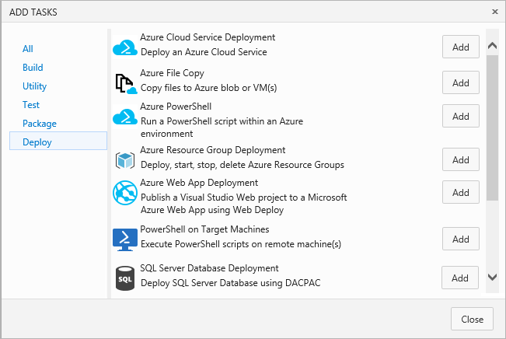
Release Management
Notes:
So even if you’re comfortable doing this manually, modern apps will wear you down
No monoliths – microservices, multiple tiers, cross-platform stuff
You’re going to have an untenable situation deploying or tracking the dev, test, and prod status of all these tiers.
So what we’re doing right now is going through screens very much like this one in our Azure account and building deployment pipelines.
Microsoft Release Management and it was available with TFS 2013 – yes, it’s been around that long –and an update came with TFS 2015 but it’s also in VSTS which is where we use it.
Nothing can go to prod until it’s been testing in dev. It really makes us feel like grownups because we’re not deploying from Visual Studio whenever we feel like it. We always know what version of the code is in which environment.

Slide 22
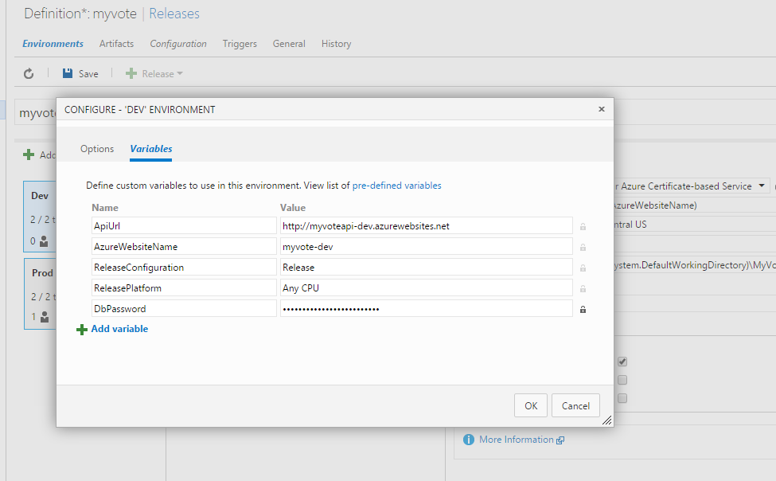
Release Management
Notes:
Environment-specific variables are stored securely inside Release Management
replaced at deployment time by PowerShell.
use a tokenized config file for deployment
not in source control!
not with developers!
you want to separate what you put TFS in charge of (build) from the deployment process. Configuration is a deployment concern, not a build concern.

Slide 23
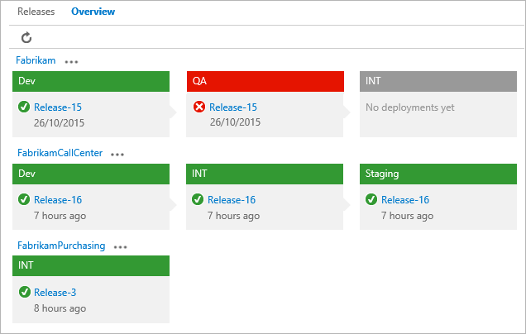
Release Management
Notes:
And what you get is this nice visualization of what’s gone live and where.
different pipelines for different pieces of the application.
Maybe the QA database is also used for staging – no big deal.
it tells you what hasn’t gone, and what’s failed, which is just hugely more transparent.
You can put who you want in charge of this –
maybe it’s developers, maybe it’s IT, maybe it’s different people in different environments.
And there are approval steps, so I get an email every time we go to test to see if I approve the release to production.

Slide 24
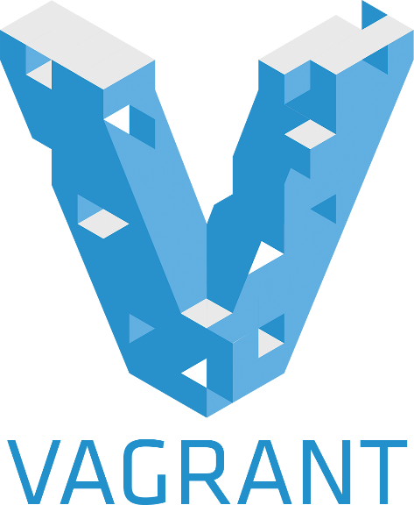

VM Management
Script your VMs rather than saving images
Work with any number of providers
Share those scripts across teams
Give those scripts to IT
Notes:
Virtual Machines are cheap and easy and fun.
There are still IT environments keeping them behind controls like they still have to be ordered over the phone and shipped 800 miles
VMs ought to be freely available. That’s how they’re most useful.
And that’s more a cultural thing, but if you’re just firing up VMware or using the Azure GUI to provision boxes, then it really is manual and piecemeal.
Vagrant and Chef Knife work with the top VM providers, so VMWare, Hyper-V, VirtualBox, or Azure.
The idea is that you provision using these scripts, so you can share the definition of a VM without throwing the whole image in a fileshare. And you know what I’m going to say next – if it’s in a text file, you can keep that in source control and get benefits of that.
You can manage what’s running with Vagrant or Chef.
if developers are spinning up environments where their software runs, and production deployments are using a different process, that’s a disconnect.
If developers use Vagrant, and Ops uses Vagrant, then that same script that brings a dev environment into the world can be the same script that’s used to provision a production VM, and that’s really important. Knife and Vagrant both put a DSL over the provisioning they do, so it’s possible (but maybe not ideal) for developers to provision Azure instances for their work while IT targets VMWare because of enterprise licensing or whatever.
Another huge benefit of Vagrant is that Vagrant minimizes the data that is stored per-VM – only the differences between that VM and the base VM stick around

Slide 25

Containers
Notes:
So what are containers and why are they called that? Think of your servers as a freight ship. The ship carries your software, which is the freight. And it used to be that freight ships just took whatever you had and shipped it, so fruit would be rubbing up against seafood, which would be laying on top of furniture – so this was crazy and completely untenable. Ships got dirty, and freight got cross-contaminated, and it was difficult even to understand how much it would cost to ship your stuff because messy stuff costs more than boxy stuff. And the job was dangerous – handling freight meant handling steel or dairy products or textiles.
Then they invented containers. As long as you could fit your stuff in the container, it cost a certain amount to ship it. Your stuff didn’t touch anyone else’s stuff, and it didn’t come in physical contact with the ship itself. People who worked with it got good at moving containers, not the stuff inside them. And look, the same container can go on our rail system. And the same container can go on our highway system. Once they solved that problem, things were a lot cleaner and more efficient.

Slide 26

Containers
Operating System
Sandbox
Container
Container Layer
“Operating System”
Not virtual machines, virtual kernels
Good fences make good neighbors
Easy to install, easy to upgrade, easy to move
Notes:
That’s the metaphor we’re using for virtualization at the kernel level – my software would be a lot happier if it were the only thing running on the machine. Containers do the management work so that’s possible – every time a containerized application asks for something that the OS could provide, the container layer intercepts that request so that the containers don’t interfere with each other or with the underlying operating system.
There are constraints. You have to fit your stuff into the container, right? If you’ve dealt with any kind of sandboxing, you know that you might not even realize the functionality you’re using is tied to the operating system until you try to containerize it.
But the benefits are crazy. You tell Docker that you want to be running an application, one that’s already in a container, and it’s lightning fast. There’s no installation once the container is moved down – all that customization or registration you might do before you start up is already done. You want to upgrade the application, you just replace the container. If you want to move it, you can move it. If you want to remove it, you don’t have to uninstall. It’s like popping a disc out of your Xbox and putting a new one in. Except you can be running two at the same time.
way way easier than throwing code over the wall at IT and hoping that they can install it
containers are, well, self-contained. anyone who is managing docker can see what’s running here and what needs to change to “install” the new container on the right server.
This is huge if we’re trying to deliver value quickly to a customer. Simplified deployment means that tested code doesn’t wait any longer than it has to before it goes to production.
This is kind of strange coming from a Microsoft world, where you have to install and register and you’re never sure what else is running, but this is happening for Microsoft stack developers.

Slide 27
Today
nginx? mysql?
Linux Servers?
Ruby?
Some cross-platform functionality, but…
Notes:
What do I specifically mean when I say that Microsoft stack developers are a little left out
You can be up and running with a Vagrant image running MySQL or Docker container with nginx in about 60 minutes.
Containers are a linux technology
When we talk about Containers that’s linux containers
You can run this stuff on Windows, but you’ll be managing Linux VMs and Linux containers. That’s today.
In the future, more operating systems will have containers
Ruby is the language that you use with Chef, and Vagrant is written in Ruby
All of this can make a Microsoft developer feel left out.
Maybe you can work with C# in some of the more pluggable tools, but it never feels like a designed-for-me devops experience
I’m sympathetic to the idea that this is supposed to save me work, not have me spend a weekend with a tool only to find that its support of my workflow isn’t ideal.

Slide 28

Microsoft
Windows sysadmin interface
Overlapping functions in cutting edge organizations
The open source community
Notes:
why aren’t Microsoft developers involved here?
I think it’s got a lot to do with the world-class ease of use when you do Windows system administration
point and click.
I talk admins who are still not sure why they’d want to go back to a command line when they know how to do something in a GUI.
good GUI. But people use GUIs, and people make mistakes, and scripts never do.
The organizations that have led the charge here are the ones who are resource constrained.
That’s a little counterintuitive, but
necessity has been the mother of invention in startups, smaller orgs, or companies that are chiefly about technology,
those organizations just don’t tend to use Windows.
Those are the ones where people have had their heads in both worlds, dev and ops.
when resources are tight, open source software enters the picture.
It’s open source tools that attract the broader community, and those are the efforts that go furthest.
So it’s no mystery

Slide 29
Today
Develop Rapidly
System Center
Azure Diagnostics
Gather Metrics
Trello
GitHub
Yammer
Slack
Tear Down Walls
Release Management
TFS
Deploy Confidently
Desired State Configuration
PowerShell
NuGet
Notes:
So if you’re a Windows developer and you want to pull DevOps stuff in, leaving the cultural stuff completely aside, what could you do?
We talked about Release Management. I think there’s a lot to like about that product but at the very least you’ll have separated your deployments from your builds and you will have entrusted your secrets to a piece of software that injects them into configuration at deployment time. That’s great. If you have some money, Octopus Deploy does the same thing, much more robustly.
If you don’t really need to track builds from environment to environment, and you like PowerShell, you can start to automate things pretty aggressively

Slide 30
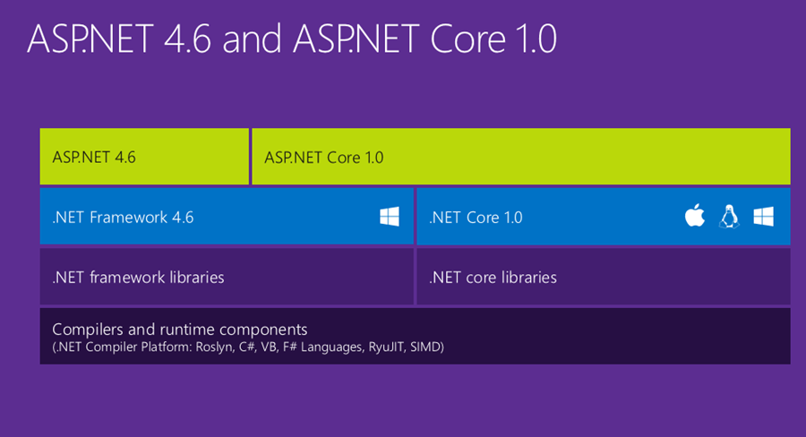
Very Near Future
Notes:
But that’s making do, and for right now.
Maybe now you understand why there’s such a push for Core.
MVC app on Core can be deployed to a linux box in the cloud with just Vagrant.
Microservices running on Kestrel, using OWIN, don’t need a full IIS install or even the Windows license.
Everything built on core will run on Linux machines and in containers. Managed by Docker. Managed by Chef.
Things are going to get very exciting when this is fully baked. We are dying to do this for components of MyVote, and it might be more expensive, because we’ll need VMs to run them, as opposed to just Azure Websites, but it’s totally worth it!

Slide 31
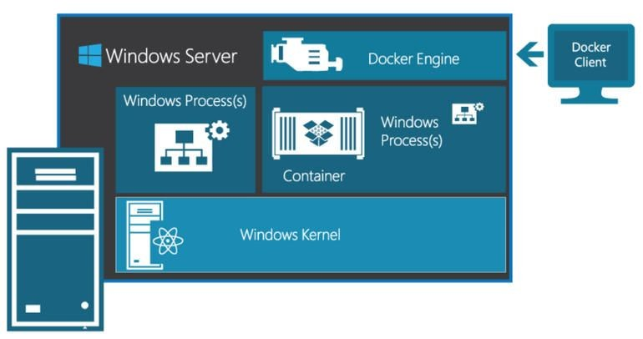
Eventual Future
Notes:
Containers are such a useful abstraction I think every operating system is going to need it
Microsoft agrees and is working on it for Windows Server 2016.
This is in progress, and there are two flavors: Windows Containers and Hyper-V Containers
Basically, Windows Server Containers share the kernel across all containers
And Hyper-V gets its own virtual kernel.
You’re going to be able to manage these with PowerShell or Docker, so again, I think this is a great design choice by Microsoft – there won’t be a competing container management framework.
Containers in the Microsoft space are going to make it so easy to deploy and upgrade applications.

Slide 32
Fill out the Evaluations
Thank you!

